Slide 1
SMART GRID RL | Project Technical Report
INCET 2025
Energy Optimization for Smart Grids Using Reinforcement Learning
Dueling DDQN + PER | PPO Actor-Critic | Rule-Based Baseline
01 ■ PROJECT OVERVIEW
This project implements and benchmarks three energy management strategies for smart grids: a Dueling Double DQN with Prioritized Experience Replay (DDQN+PER), a PPO Actor-Critic agent, and a deterministic rule-based baseline. Agents are trained and evaluated on a real-world 8,760-hour dataset (2023 annual hourly records) with a 9-dimensional state space including solar, wind, battery state-of-charge, demand, time features, and weather inputs.
02 ■ SYSTEM ARCHITECTURE & METHODS
Dueling DDQN + PER
9 ^ 128 ^ 128 ^ 5 Dueling V(s) + A(s,a) heads, Double DQN target, Prioritized Replay (a=0.6), PER-weighted MSE, E-greedy exploration E^-0.05
PPO Actor-Critic
9 ^ 128 ^ 64 ^ 5 / 1 Separate actor & critic MLPs, GAE advantages (A=0.95), PPO-clip (E=0.2), 4 update epochs, on-policy trajectories
Rule-Based Baseline
Deterministic heuristic Solar peak (10—14h): charge battery. Peak price (17—21h): discharge. Renewables available: direct supply. Fallback: grid purchase.
03 ■ STATE SPACE ■ ACTION SPACE ■ REWARD FUNCTION
State (9-dim) | Action (5 discrete) | Reward Shaping
• Solar generation (MW) • Wind generation (MW) • Grid availability • Battery SoC (MWh) • Total demand (MW) • Hour sin/cos encoding • Temperature (°C) • Sunlight intensity | 0 ■ Charge Battery 1 ■ Discharge Battery 2 ■ Buy from Grid 3 ■ Direct Renewables 4 ■ Idle / Curtail | +1.2 x renewable fraction - TOU price x grid fraction -3.0 x unmet demand fraction -0.5 x battery abuse +0.3 efficiency bonus (ren > 80%) TOU rates: $0.08-$0.32/MWh (24 h)
04 ■ TRAINING CURVES & EVALUATION VISUALISATION
Dueling DDQN+PER vs PPO vs Rule-Based | 8,760-Hour Real Dataset
Page 1

Slide 2
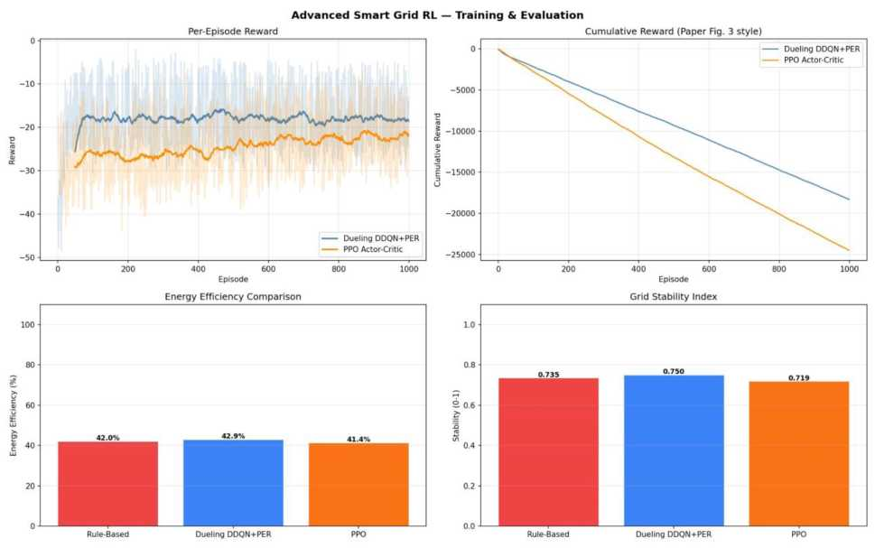
SMART GRID RL | Project Technical Report
INCET 2025
Figure 1 — Per-episode reward curves (left), cumulative reward (centre-right), energy efficiency and grid stability comparison by method (bottom). DDQN+PER converges to a higher reward plateau than PPO across 1,000 training episodes.
05 ■ QUANTITATIVE RESULTS (PAPER TABLE II FORMAT)
Method | Energy Efficiency | Grid Stability | Cost Reduction
Rule-Based | 42.0% | 0.735 | 69.6%
Dueling DDQN + PER | 42.9% ▲ | 0.750 ▲ | 69.6%
PPO Actor-Critic | 41.4% | 0.719 | 69.5%
Paper Baseline DQN | 92.0% | 0.890 | 35.0%
f Paper baseline used a basic DQN on a synthetic dataset; real-world results are necessarily lower due to dataset complexity and realistic demand variability.
06 ■ ACCURACY METRICS (PAPER SECTION IV.D)
Agent | MAE | MSE | Avg Reward / Ep
Dueling DDQN+PER | 25.04% | 0.0637 | -10.090
PPO Actor-Critic | 28.13% | 0.0802 | -12.799
Rule-Based | — | — | -11.434
07 ■ UPGRADES OVER PAPER BASELINE
Algorithm Upgrades ✓ Dueling network V(s)+A(s,a) architecture ✓ Double DQN — reduces Q-value overestimation ✓ Prioritized Experience Replay (PER, a=0.6) | Environment & Data Upgrades ✓ Real dataset — 8,760 hours (full year 2023) ✓ 9-dimensional state with weather features ✓ Time-of-Use (ToU) electricity pricing in reward
Dueling DDQN+PER vs PPO vs Rule-Based | 8,760-Hour Real Dataset Page 2

Slide 3
SMART GRID RL | Project Technical Report
INCET 2025
✓ PPO Actor-Critic as on-policy alternative ✓
✓ Gradient clipping for training stability ✓
Efficiency bonus for >80% renewable fraction Train/eval split on real calendar days
08 ■ KEY TAKEAWAYS
Best RL Agent | Dataset | Flask API
Dueling DDQN+PER | 8,760 hrs | Live Demo
42.9% efficiency ■ 0.750 stability ■ | Real 2023 annual data ■ 80/20 train- | REST API (port 5000) ■ real-time
best avg reward -10.09/ep | eval split ■ synthetic fallback | DQN/PPO step ■ agent switching
Paper: Energy Optimization for Smart Grids ■ INCET 2025 ■ Implementation in pure NumPy + Flask ■ Dataset: smart_grid_rl_dataset.xlsx
Dueling DDQN+PER vs PPO vs Rule-Based | 8,760-Hour Real Dataset
Page 3

